Slide 1
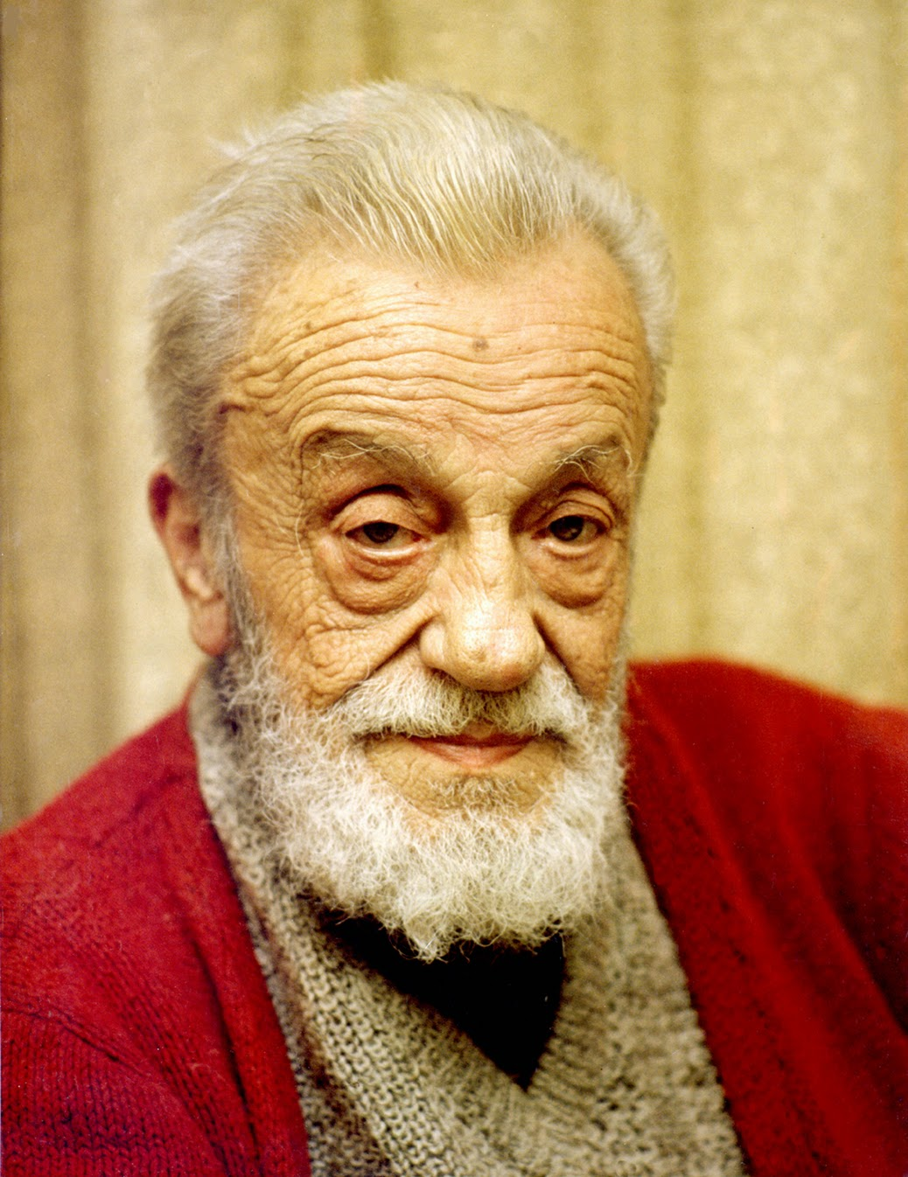

NECIP FAZIL KISAKUREK
•POET
•NOVELIST
•PLAYWRIGHT
•ISLAMIST IDEOLOGUE
MAY 26 1904 – MAY 25 1983

Slide 2

~ ABOUT HIS LIFE ~
~ He was born on May 26 1904 in Istanbul as a child in a family from Marash.
~ He was a poet, a novelist, a playwright and an Islamist ideologue.

Slide 3
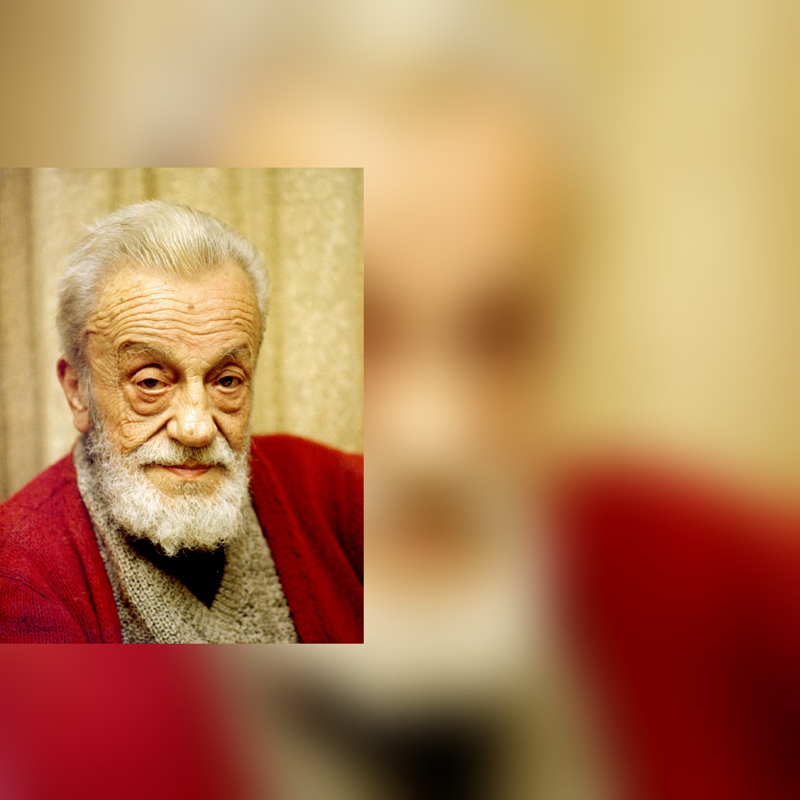
~ ABOUT HIS LIFE ~
~ His main interests are poetry, politics, literature.
~ When Necip Fazıl was 17, his first book of poetry was published who started to write poem at the age of 12.

Slide 4
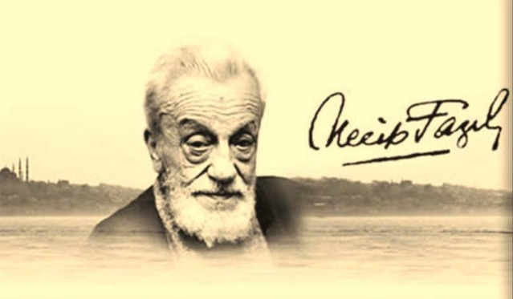
• HIS LITERATURE CAREER •
~ He is also known simply by his initials NFK.
~ At the age of 24 he was recognize with the published second book of poems “Pavements”

Slide 5
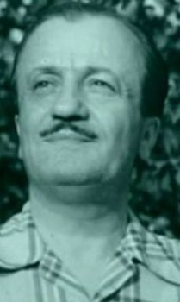
• HIS LITERATURE CAREER •
~ Before his 30, he published A new book of poetry called “Me And Beyond” So he continued to win recognition.
~ The much-loved poet by many people started to call “Master Necip Fazıl Kısakurek”

Slide 6
~~
~ In 1980, in an official ceremony The Turkish Foundation For Literature granted him the “Sultanı Şuara” (Mastermind) title.
~ Necip Fazıl Kısakurek died in Istanbul on May 25 1983.

Slide 7
•SOME OF HIS IMPORTANT WORKS ;
POETRY
~ Spider Web (1925)
~ Pavements (1928)
~ Me And Beyond (1932)
~ Anguish I-II (1962-1974)
• • and more...
NOVELS
~ The Lie In The Mirror (1980)
PLAYS
~ To Create A Man
~ Mr. Judge
~ Stone Of Patience
~ The Man With Black Cloak
~ Fingerless Salih
• • and more...

Slide 8
THANKS FOR YOUR INTEREST
Prepared by;
Ebrugul Tas from Turkey

